Slide 1

Binary Search Trees: Search Trees
Saif Hassan
Department of Computer Science
Sukkur IBA University
Data Structures
Data Structures and Algorithms
Notes:
<number>

Slide 2
Agenda
Array Search
The search tree structure
Notes:
<number>

Slide 3
Learning Objectives
Describe how a Binary Search Tree data structure is constructed.
Determine whether a tree is properly sorted.

Slide 4
Last Time
Want data structure for local search.

Slide 5
Last Time
Want data structure for local search. None of the existing data structures work.

Slide 6
Last Time
Want data structure for local search. None of the existing data structures work.
Sorted arrays can search but not update.
Notes:
Sorted arrays were okay, in that you could actually do searches efficiently on them.
But unfortunately, you couldn't do updates in any reasonable way.
But the fact that these things allowed for efficient binary searches sort of
maybe gives us a good starting point for what we're looking for.
<number>

Slide 7
Agenda
Array Search
The search tree structure
Notes:
<number>

Slide 8
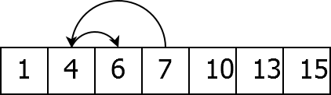
Binary Search
Search an array:
Notes:
So, what we should look at is,
we should really see this operation of binary search.
What does it entail, and what exactly makes it work?
And so we all know how a binary search works, right?
So you've got your list of numbers, you pick the one in the middle.
You ask, is the thing I am looking for bigger than this or less than this?
If it's smaller, I sort of look at the middle of first half of the array, and
say, is it bigger or less than that?
<number>

Slide 9
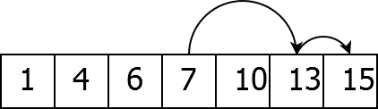
Binary Search
Search an array:
Notes:
If it's larger, I look to the second half of the array, and ask,
is it bigger or less than that?
And I sort of keep on asking these question and
each time it sort of narrows down my search space until I get an answer.
<number>

Slide 10
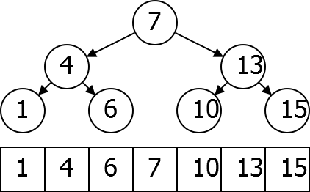
Search Tree
Consider questions asked:
The search tree is much easier to insert into.
Notes:
But as you'll note,
sort of associated to this sort of binary search procedure is a search tree.
If you sort of consider which questions you ask.
First, I ask about, is it bigger or less than seven?
If it's smaller, I ask about four.
If it's bigger, I ask about 13.
If I got four and said it was bigger than four, I'd then ask about six.
And I have this sort of whole tree of possibilities.
Every time I ask a question it sort of splits into two different cases.
<number>

Slide 11
Agenda
Array Search
The search tree structure
Notes:
<number>

Slide 12
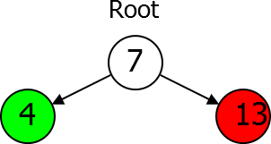
Parts of a Tree
Root node.
Left subtree smaller keys.
Right subtree bigger keys.

Slide 13
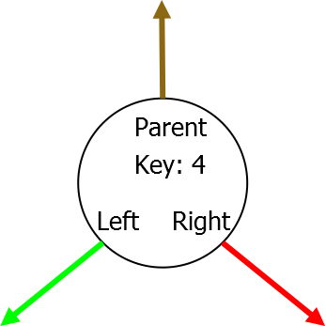
Tree Node Data Type
Key Parent Left Child
Right Child

Slide 14
Search Tree Property
X ’s key is larger than the key of any descendent of its left child, and smaller than the key of any descendant of its right child.

Slide 15
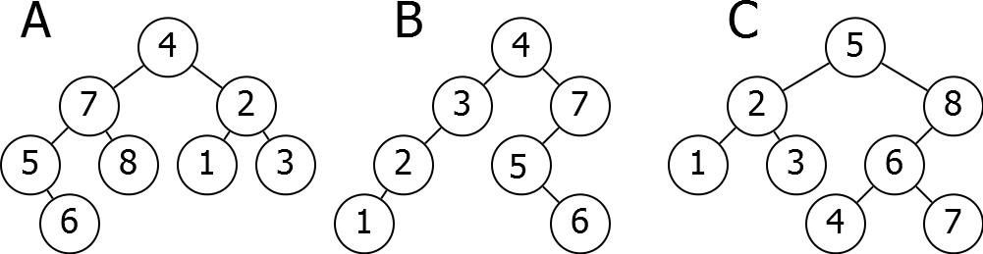
Problem
Which of the following Trees satisfies the Search Tree Property?

Slide 16
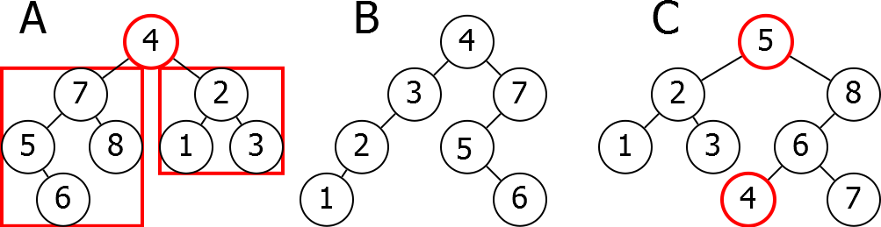
Problem
Which of the following Trees satisfies the Search Tree Property?

Slide 17
Next Time
How to do basic operations on Binary Search Trees.

